Slide 1
CRIME PREVENTION THROUGH ENVIRONMENTAL DESIGN (CPTED)
CLOSED CIRCUIT TV (CCTV)
SECURITY CAMERAS

Slide 2
DEPUTY WILLIAM R. HART
Harris County Sheriff’s Office
23 years of experience
Assigned to District 4 patrol in the Barker Cypress MUD contract

Slide 3
HISTORY OF CCTV
Invented by Walter Bruch
First installed in Germany in 1942 for the launch of V-2 rockets.
U.S. first commercial closed-circuit television system became available in 1949.
First public surveillance appeared in the US in 1973, in Times Square New York City by NYPD to deter crime.
1980’s video surveillance began to spread, targeting public areas. Cheaper way to deter crime opposed to increasing police departments.
During the 1990s Digital multiplexing increased the use of CCTV across the country.
The attacks on September 11 increased the use of video surveillance to deter terrorist attacks.
Public and private use of surveillance cameras has become widespread due to the increase of crime.
Notes:
digital multiplexing, which allowed for several cameras at once to record, and introduced time lapse and motion only recording,

Slide 4
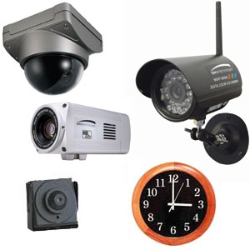
TYPES OF CCTV
There are several types of CCTV including the following:
Dome
Infra Red
Bullet
Wireless
Varifocal
Discreet
Covert

Slide 5
TYPES OF CCTV cont.
Network/IP:
Hardwired or wireless
Transmit images over the Internet
Often compressing the bandwidth so as not to overwhelm the web.
Wireless:
Not all wireless cameras are IP-based.
Some can use alternative modes of wireless transmission.
The primary benefit to these units is still the same: extreme flexibility in installation. PTZ/Speed Domes:
Pan/tilt/zoom cameras.
These are relegated to surveillance situations where there is an actual live guard or surveillance specialist monitoring the images.
High-Definition Cameras:
Relegated to niche markets, such as casinos.
Ability to zoom in with extreme clarity.

Slide 6
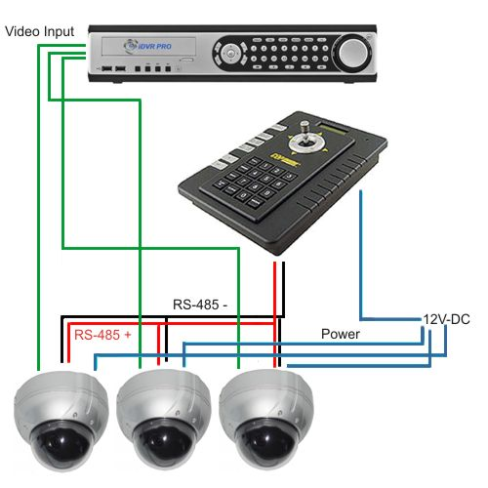
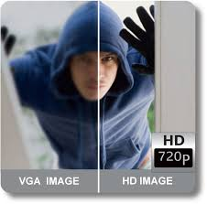
PTZ and High Def camera systems can be purchased from $500 to thousands of dollars.

Slide 7
CONSIDERATIONS
How Important are Home Security Cameras?
Intruders plan break-ins when you’re not at home or asleep.
Vision or sight is compromised. Security cameras give you sight.
Before you bury yourself in security camera research ask yourself a few key questions:
Do you want cameras installed outside, inside or both?
Do you have specific areas or rooms you’d like to focus on?
Do you want a record of camera or video data?
What is your budgetary limit?
Can you install yourself or will you need a contractor?
Each of these questions narrows down your product options and gives you a much clearer idea of the cameras and video equipment you’ll need to integrate.

Slide 8
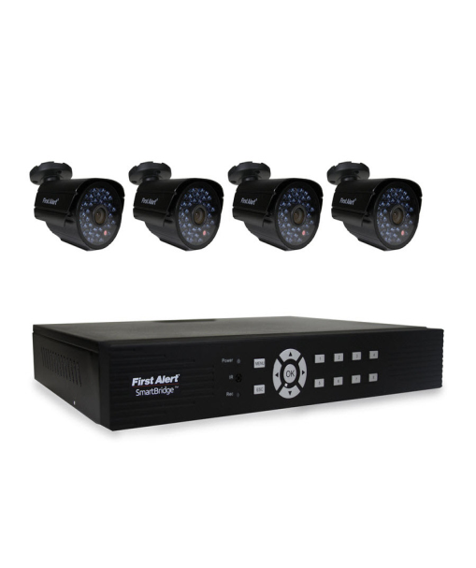
PRICE POINTS
Wired analog systems can be found from $450 to $1000 at Lowe’s Home Improvement depending on number of cameras.
Technology Analog
Image Encryption Yes
Image Type Color
Night Vision Capable Yes
Night Vision Range 61-ft to 100-ft
Indoor/Outdoor Indoor or outdoor
Record Capable Yes
External Memory SDHC (included)
Two-way Communication No
Audio Microphone Yes
Audio Speaker Yes
Connectivity Wired
Total Cameras Supported 8
Video Output Television; computer and DVR
Monitor Size Not included
Viewing Modes Manual and simultaneous
Touchscreen Monitor No
Includes Wall Mount Yes
Motion Detection Yes
Audio Detection No
Image Zoom Yes
Iris Technology No

Slide 9
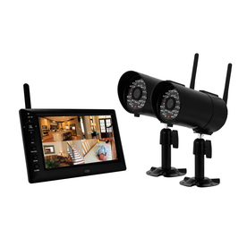
PRICE POINTS
Wireless systems can be found from $250 TO $1000 at Lowe’s Home Improvement depending on number of cameras.
Technology Digital
Image Encryption No
Image Type Color
Night Vision Capable Yes
Night Vision Range 15' to 60'
Indoor/Outdoor Both
Record Capable Yes
External Memory Micro SD
Two-way Communication No
Audio Microphone No
Audio Speaker No
Connectivity Wireless RF
Total Cameras Supported 4
Video Output Handheld Monitor
Monitor Size 7-in
Viewing Modes Manual/Simultaneous
Touchscreen Monitor No
Includes Wall Mount Yes
Motion Detection Yes
Audio Detection Yes
Image Zoom No
Iris Technology No

Slide 10
QUESTIONS

