Slide 1
Business Security Survey
3207 Williamsburg Lane
Missouri City Texas 77459 (281)403-7700

Slide 2
Section II
Site Identification
External Environment

Slide 3
Site Identification

Slide 4
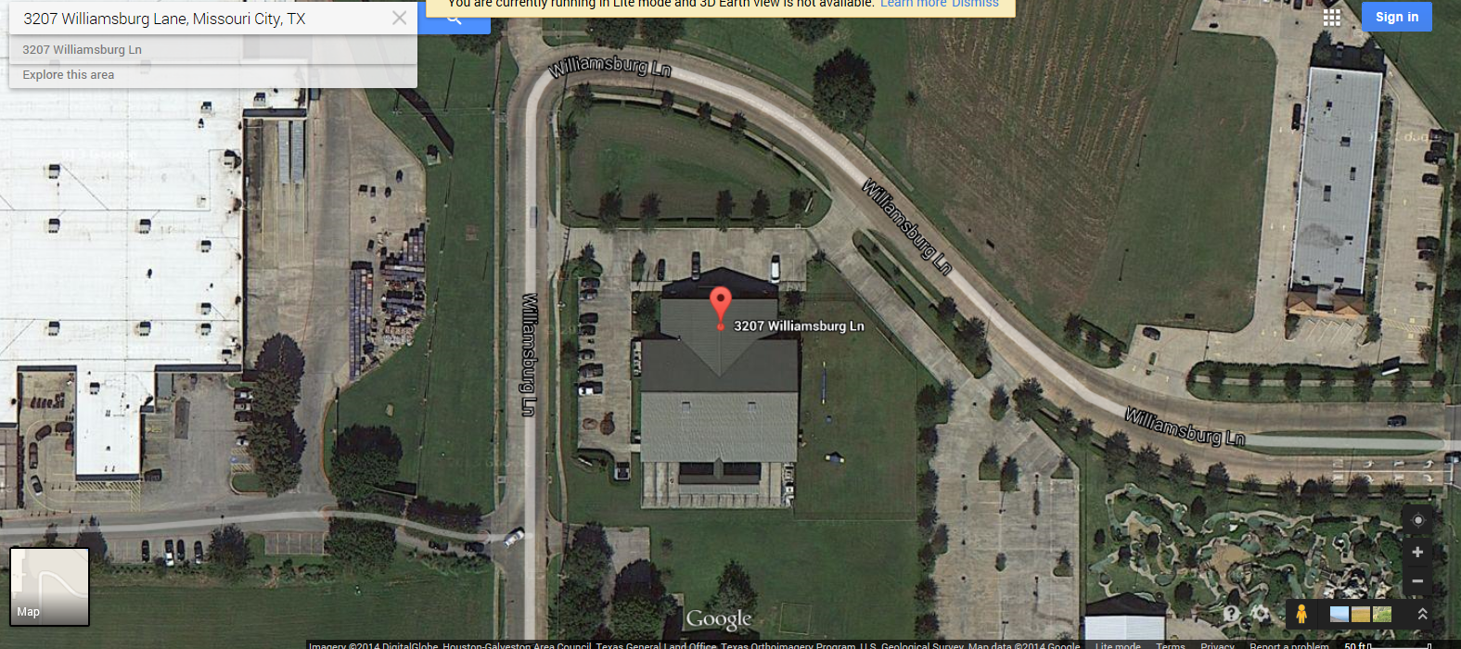
Lone Star Pet Lodges

Slide 5
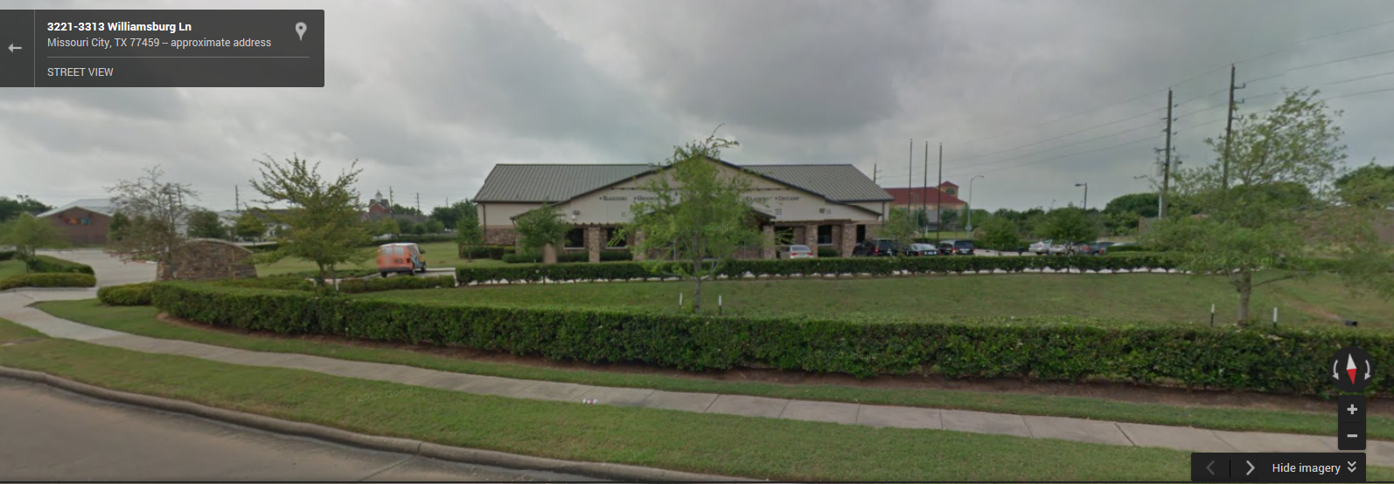
Front View

Slide 6
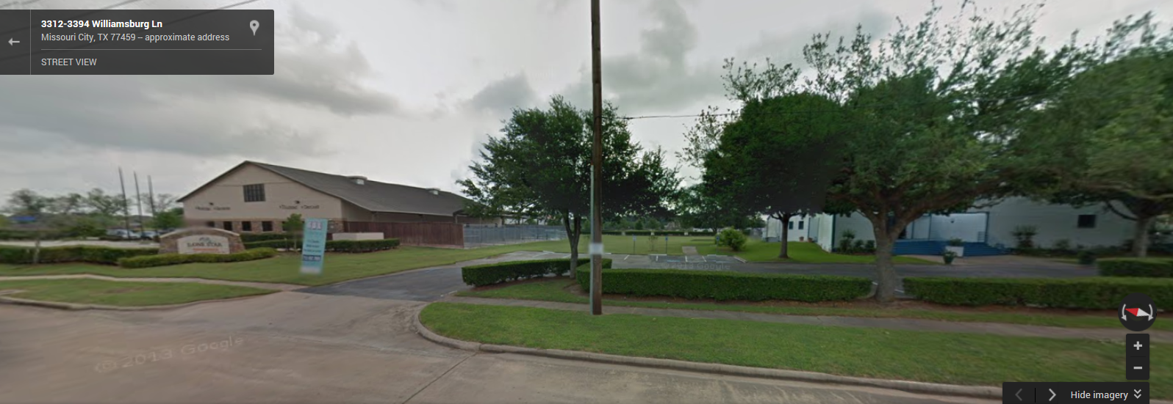
Rear View

Slide 7
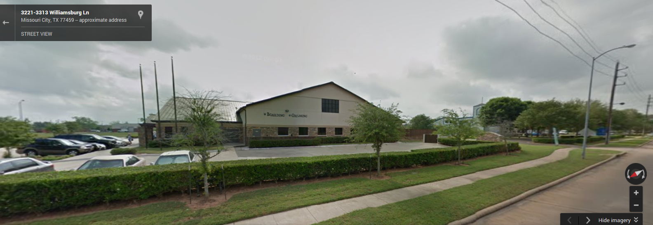
West Side View

Slide 8
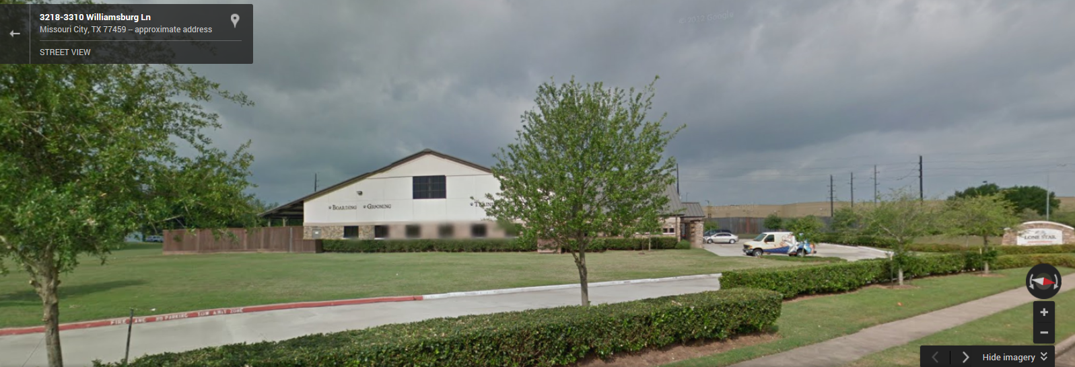
East Side View

Slide 9
Section III (Exterior)
Exterior Lighting
Fences, Shrubs and Natural Barriers
Perimeter Alarms

Slide 10
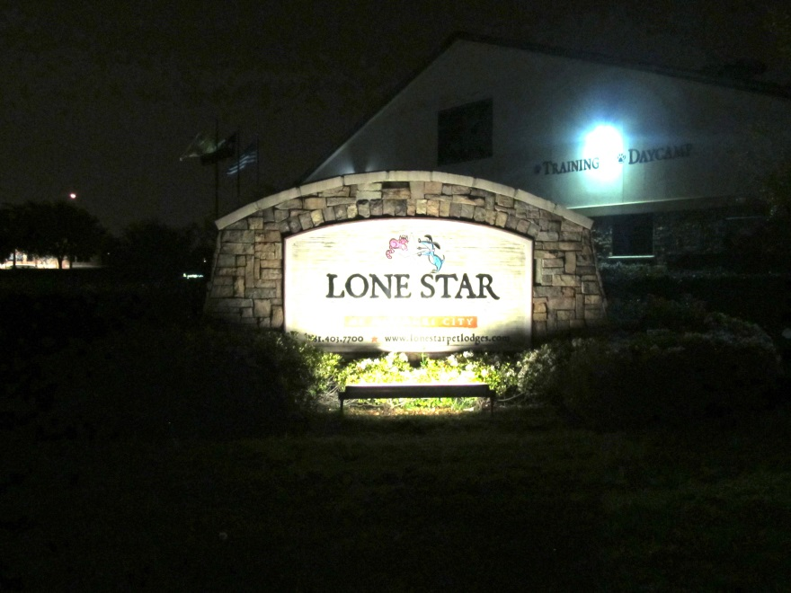
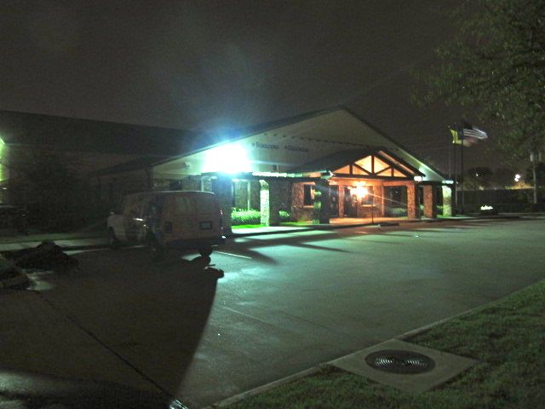
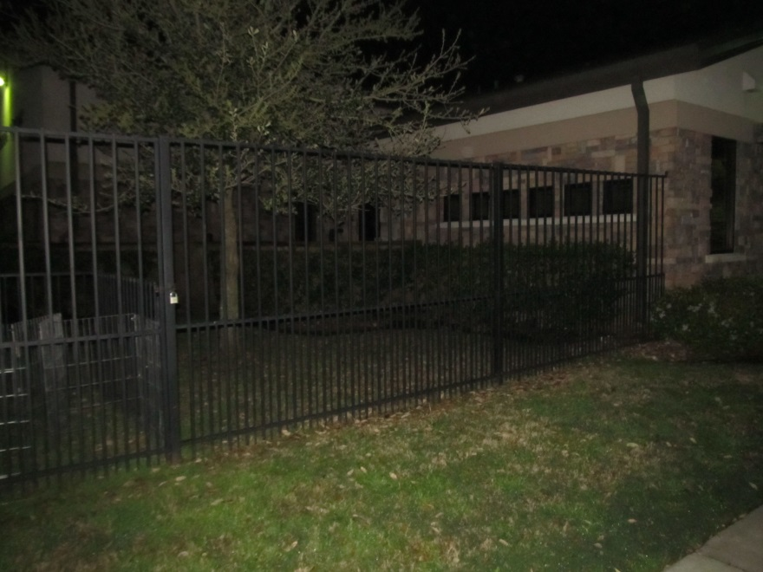
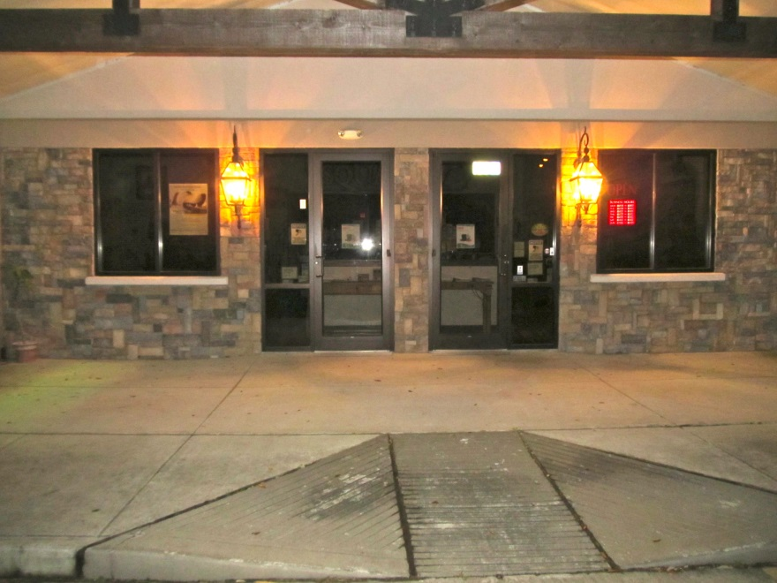

Slide 11
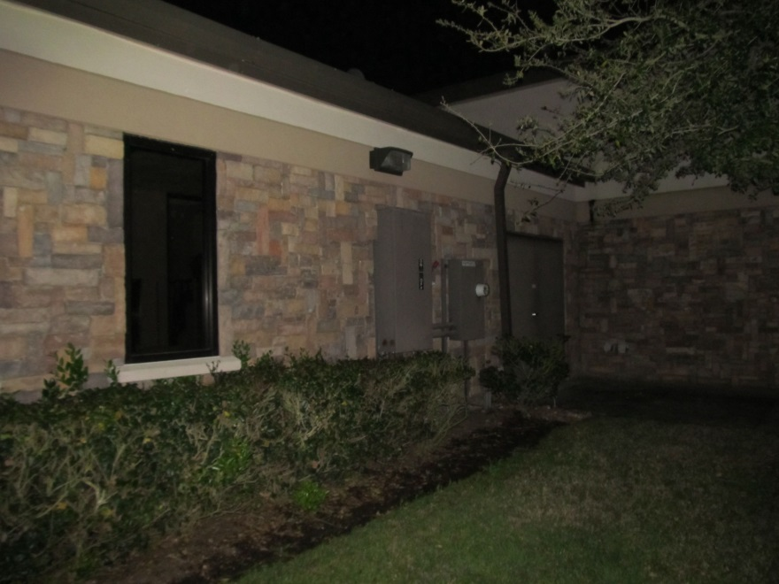
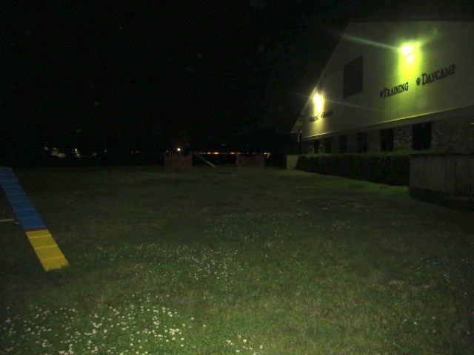
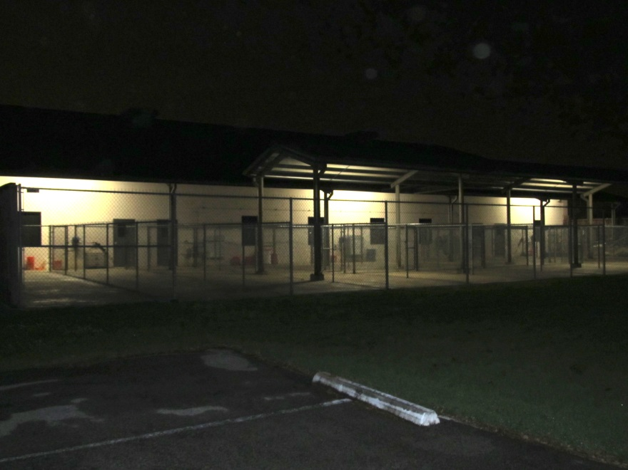
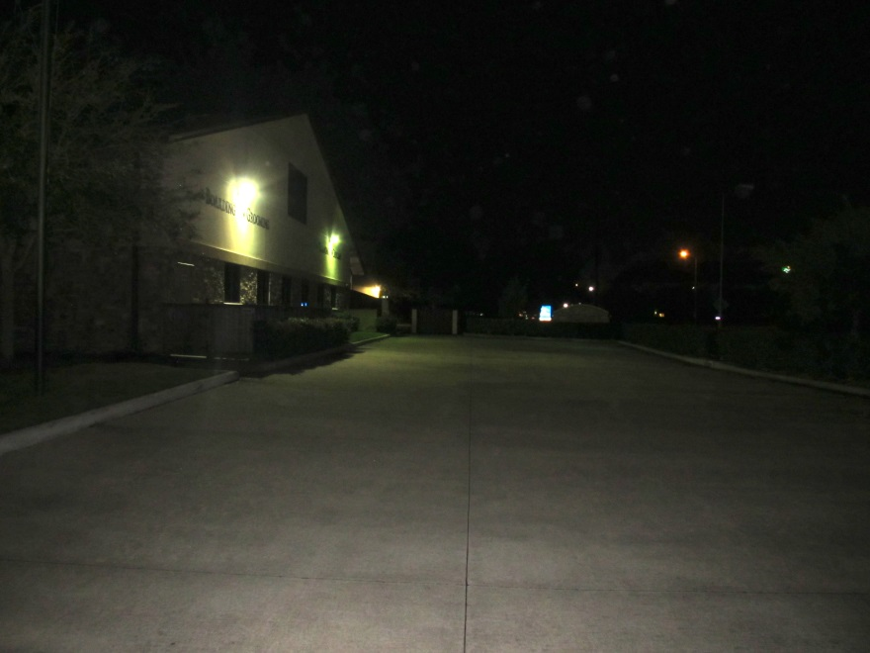

Slide 12
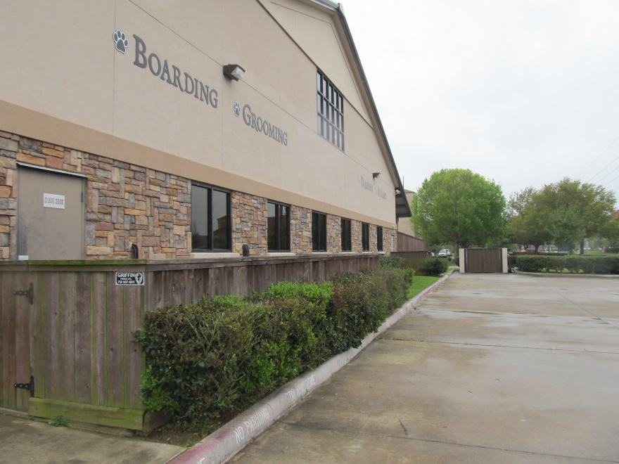
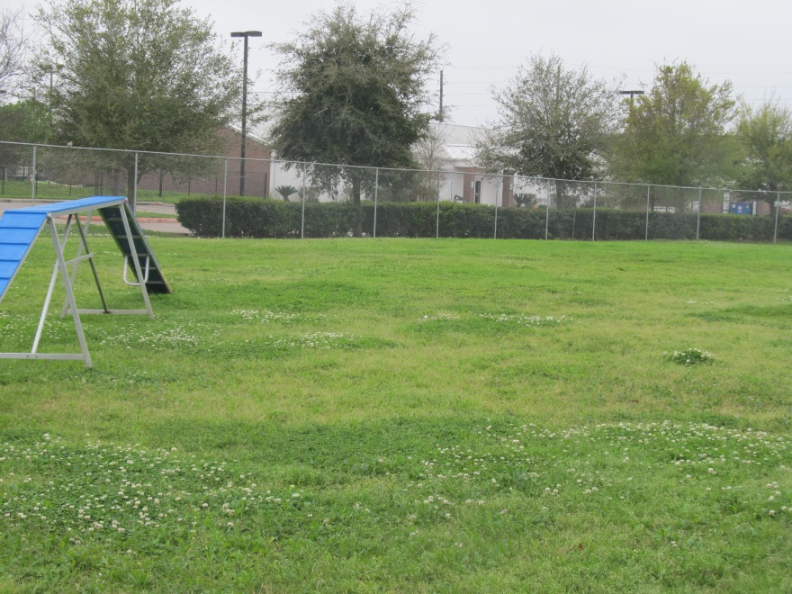
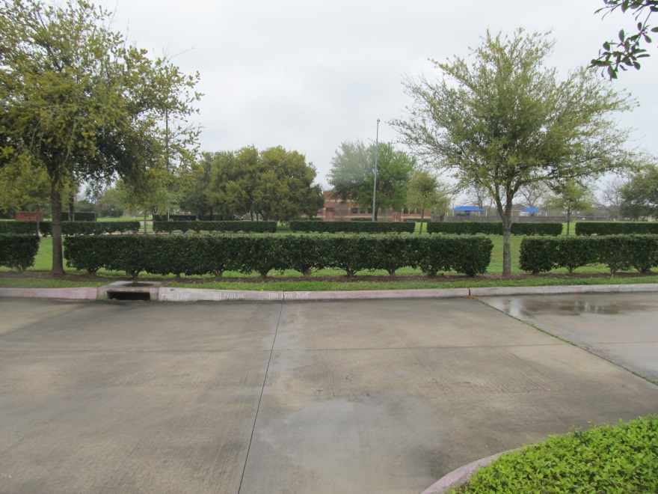
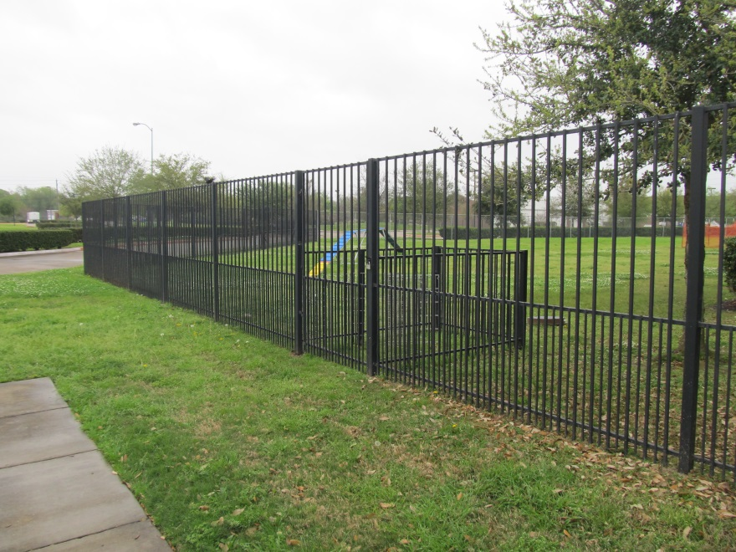

Slide 13
Section IV (Interior)
Doors
Windows
Walls
Roof
Floor

Slide 14
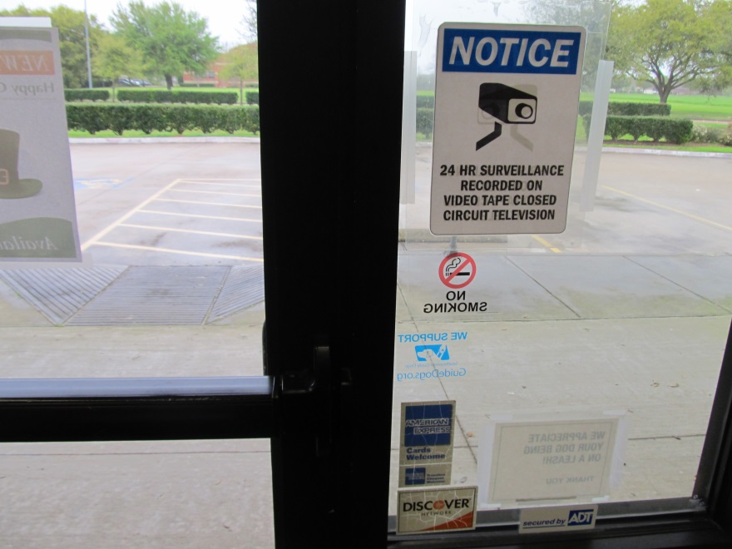
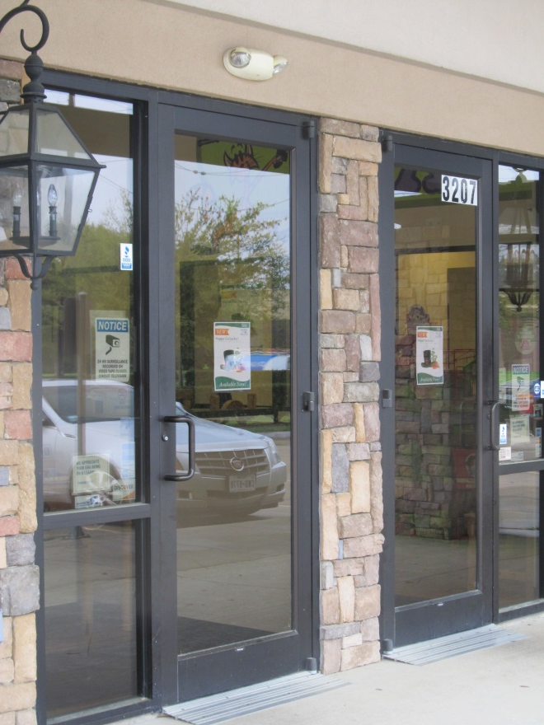

Slide 15
Section V (Interior Controls)
Doors and Locks
Interior Walls
Alarms and CCTV
Safes
Key Control
Retail Security
Checks and Credit Cards
Shop Lifting Awareness
Internal Theft
Delivery and Inventory Controls
Technology

Slide 16
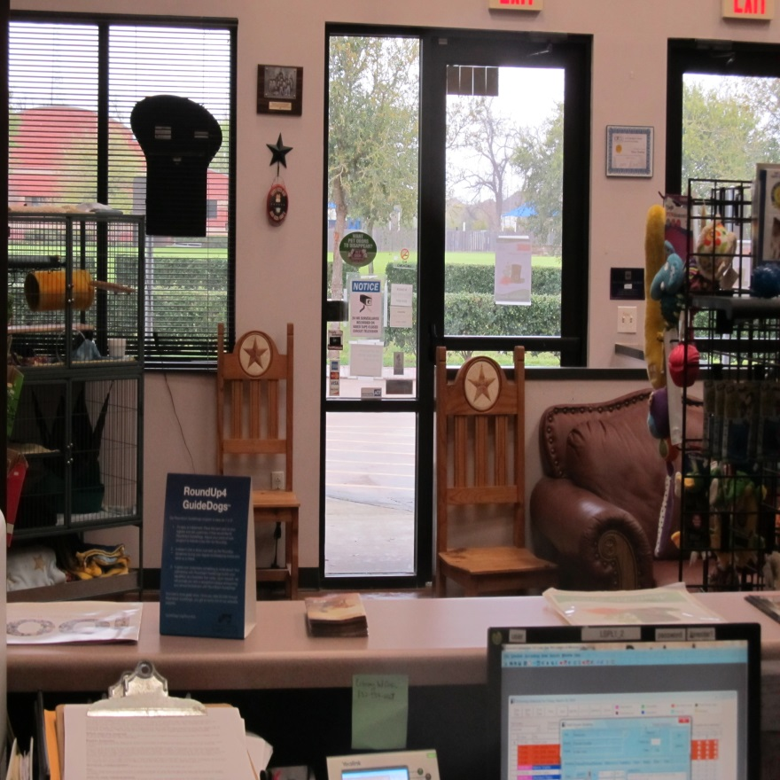
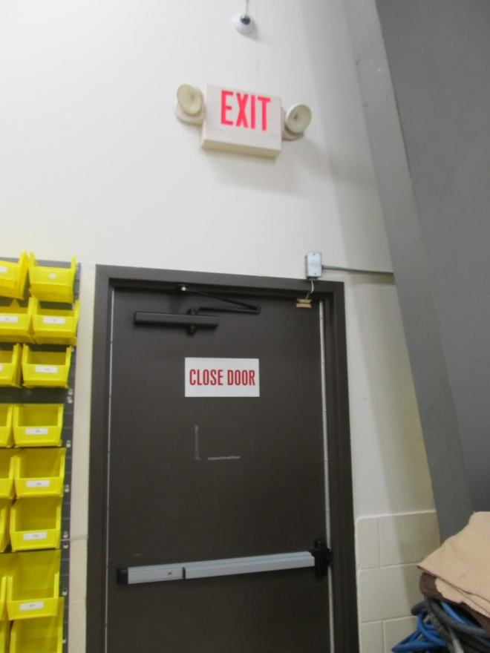
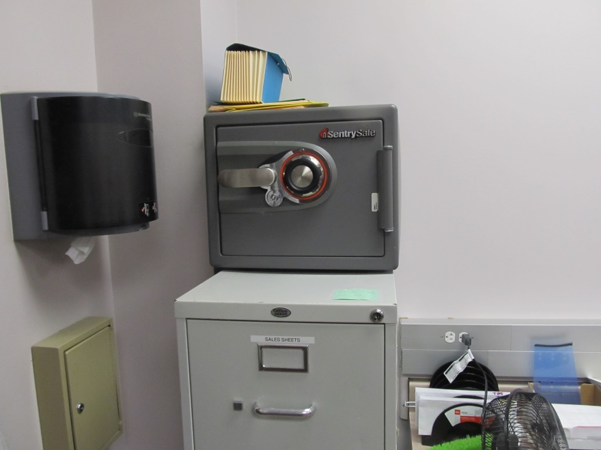

Slide 17
Section VI
Conclusion

